Slide 1
浅谈容器技术架构

Slide 2
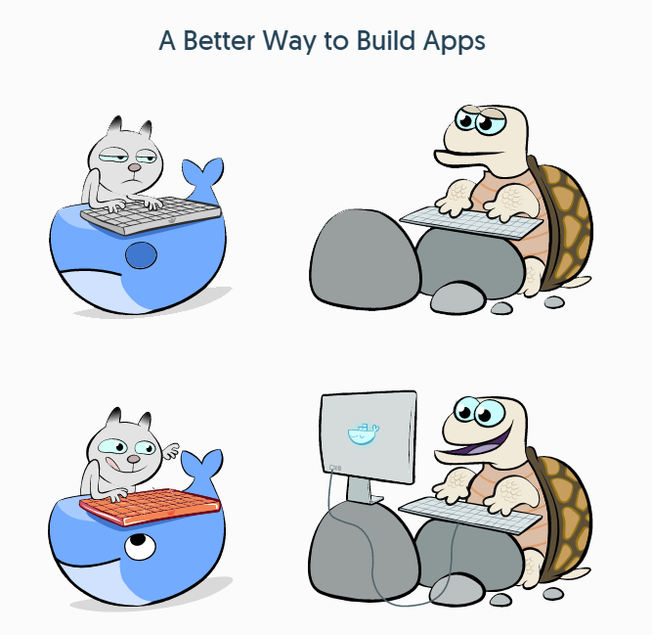
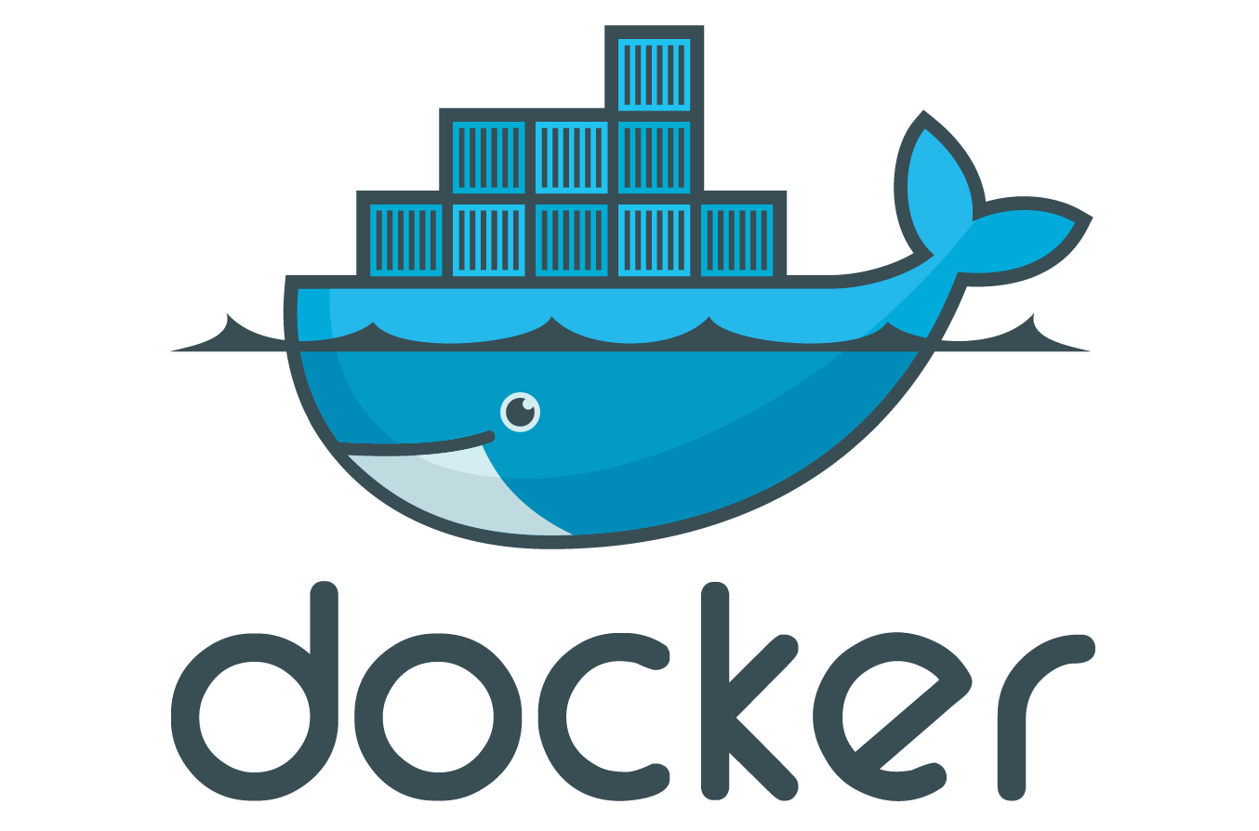
Docker - Build, Ship, and Run Any App, Anywhere

Slide 3
传统应用发布流程

Slide 4
容器应用发布流程

Slide 5
容器核心六要素
镜像
仓库
容器
build
run
ship

Slide 6
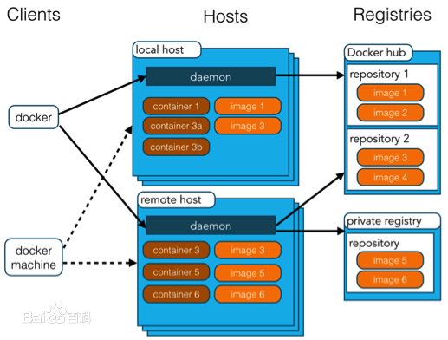

Slide 7


举个🌰
docker pull nginx
docker images
docker run -d -p 8088:80 nginx
curl http://localhost:8088
http://10.255.1.94:8088
docker exec -it name|id /bin/bash
cd /usr/share/nginx/html
mv index.html index.html.bak
echo 'hello xxx' > index.html
docker commit \
-m "momment info" \
-a "author info" \
container_id new_image_name

Slide 8
企业级Registry开源项目Harbor

Slide 9
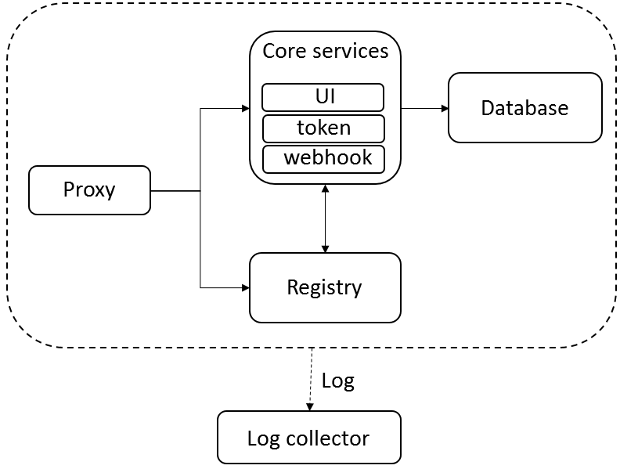

Slide 10
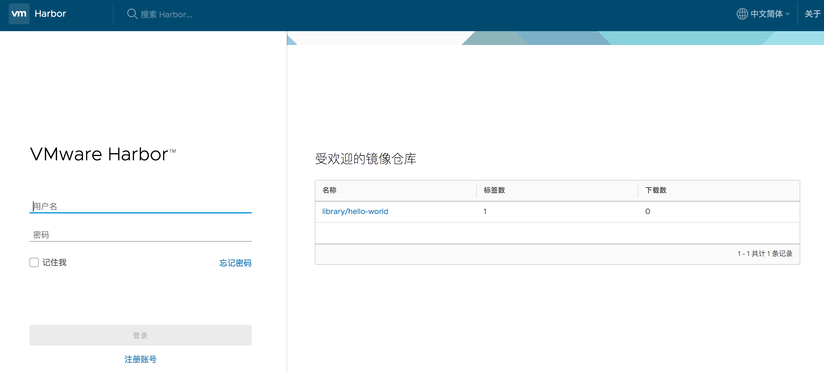

Slide 11



举个🌰
Dockerfile
FROM nginx
MAINTAINER huangyanxiang
COPY demo.html /usr/share/nginx/html
docker tag nginx-demo qsharbor:5000/library/nginx-demo
docker login qsharbor:5000
username: admin
password:
docker push qsharbor:5000/library/nginx-demo
vi demo.html
docker build -t nginx-demo .
docker run -d -p 8088:80 --name nginx nginx-demo

Slide 12


Slide 13
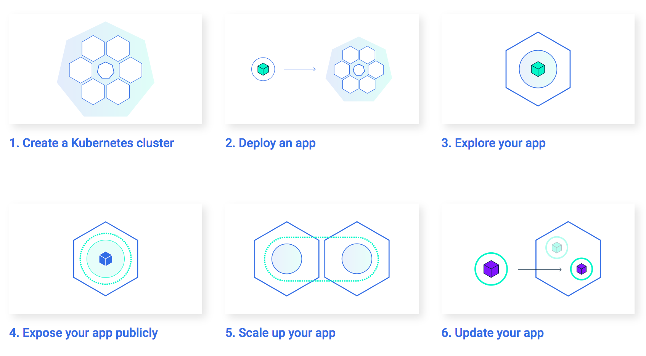

Slide 14
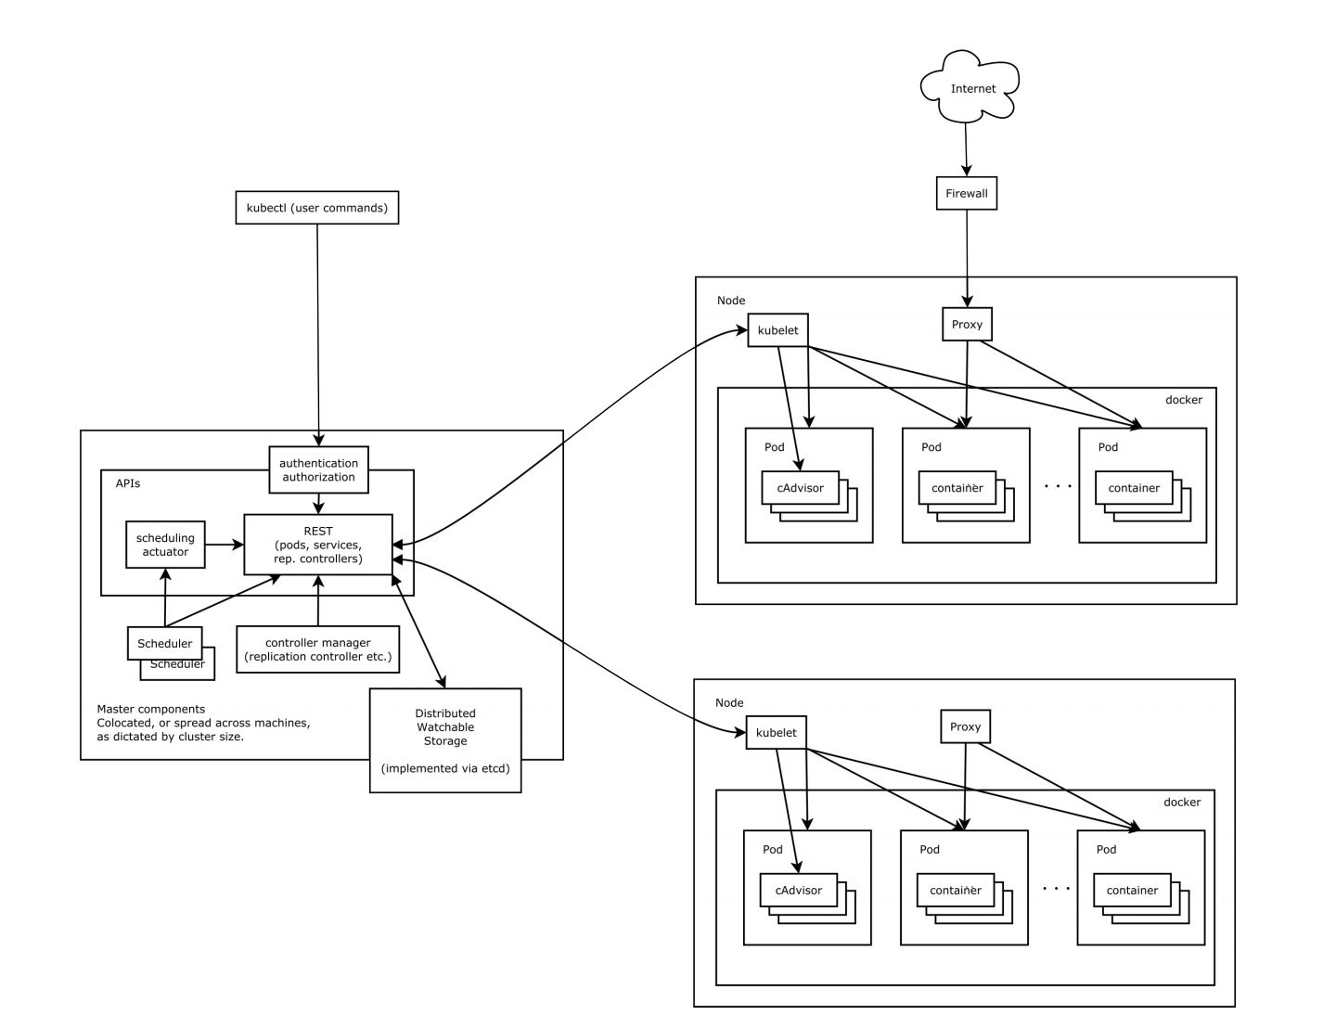

Slide 15
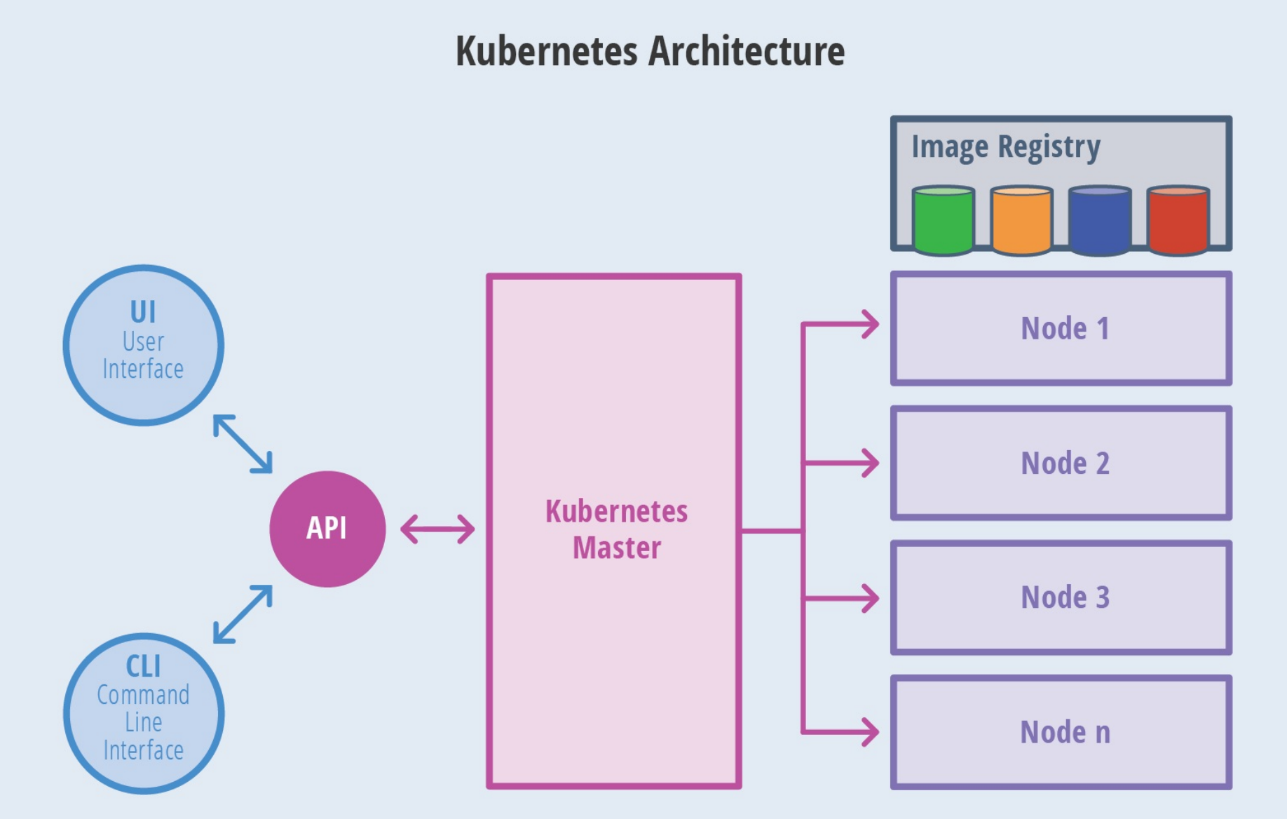

Slide 16
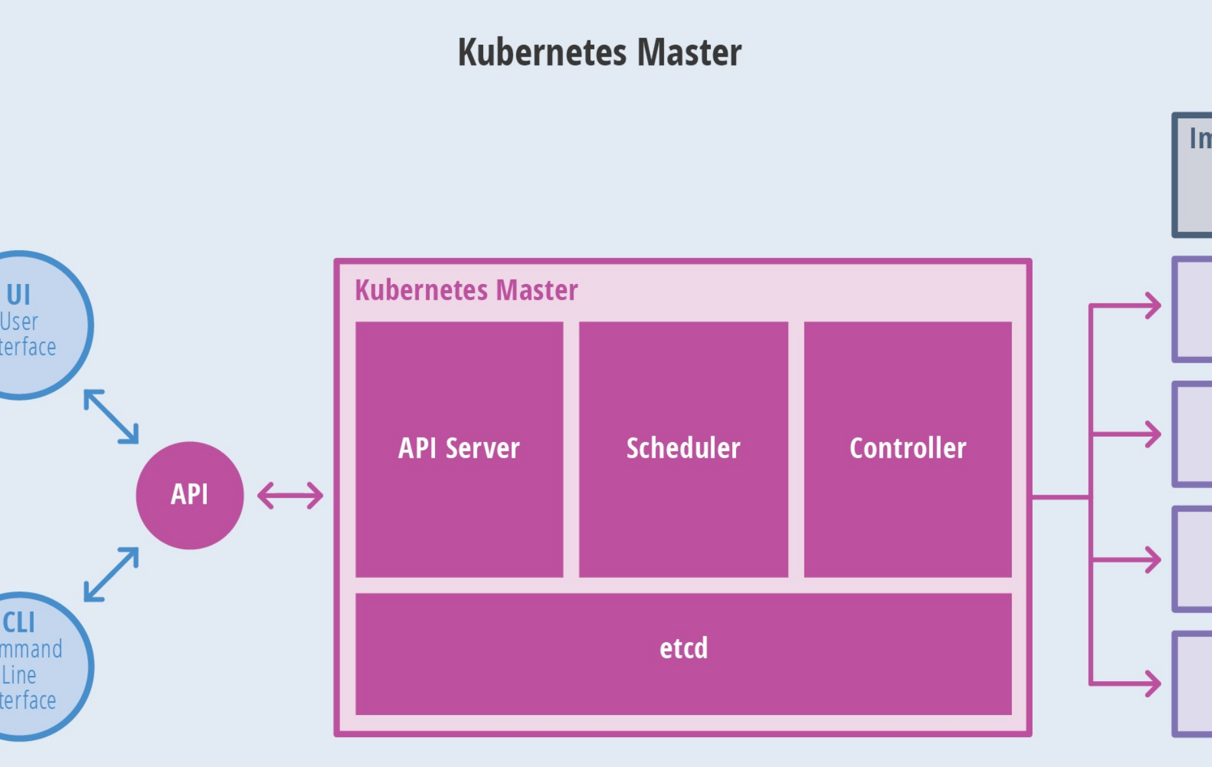

Slide 17
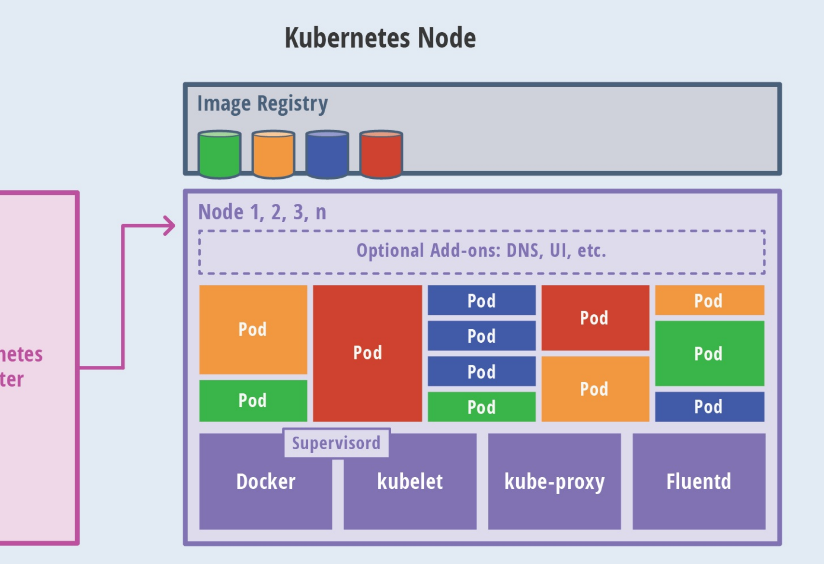

Slide 18



# nginx deployment replicas 3
apiVersion: extensions/v1beta1
kind: Deployment
metadata:
name: nginx-deploy
spec:
replicas: 3
template:
metadata:
labels:
app: nginx-pod
spec:
containers:
- name: nginx-container
image: qsharbor:5000/library/nginx-demo
ports:
- containerPort: 80
# nginx deployment expose to service, cluster port 80, nodeport random
apiVersion: v1
kind: Service
metadata:
name: nginx-service
spec:
type: NodePort
ports:
- port: 80
targetPort: 80
nodePort: 31000
- port: 81
targetPort: 81
selector:
app: nginx-pod
# single pod with hostport
apiVersion: v1
kind: Pod
metadata:
name: nginx-single-pod
spec:
containers:
- name: nginx-single-container
image: qsharbor:5000/library/nginx-demo
ports:
- containerPort: 80
hostPort: 8081
kubectl create -f .

Slide 19
K8S资源对象
master | kube-apiserver kube-controller-manager kube-scheduler etcd
node | kubelet kube-proxy docker kube-dns
pod | pause tomcat mysql
namespace | default

Slide 20
K8S资源对象
label | 给资源作标记，如node, pod, service等
replication controller | 副本
replica set | 新一代副本
deployment | 部署
horizontal pod autoscaler | 横向自动扩容
stateful set | 有状态的pod集

Slide 21
K8S资源对象
daemon set | 服务性质的pod集
service | 服务，最核心的资源对象
volume | 存储卷
persistent volume | 只能是网络存储，声明式存储，某个网络存储中对应的一块存储
namespace | 命名空间
annotation | 与label类似，但更随意，注释

Slide 22
K8S资源对象
job | 任务，一次性
cron job | 周期任务
ingress | 连接服务的规则集合，如/web -> tomcat-api
hpa | horizontal pod autoscaling, 横向自动扩展

Slide 23
服务发现与负载
load balancer
Cluster
NodePort
service
Cluster Ip ,Port
NodePort
Node Ip
Node Ip
pod
Pod IP, targetport
pod
pod
Node1
Node2

Slide 24
集群DNS
8.8.8.8
out dns
load balancer
Cluster
NodePort
service
Cluster Ip
NodePort
Node Ip
Node Ip
up-dns
dnsmasq
pod
pod
Pod IP
dns
Node1
pod
Node2

Slide 25
kube-proxy
load balance
service
Cluster
NodePort
NodePort
Node Ip
Cluster Ip
Node Ip
iptables
pod
pod
iptables
proxy
proxy
Node1
Node2

Slide 26
Ingress
domain/api, other/api
domain/web
service
Cluster
Node Ip
proxy
Node Ip
pod
pod
ingress
ingress
Node1
Node2

Slide 27
DEMO
分布式云调度系统

Slide 28
云调度
QS-Scheduler
job
executor
core

Slide 29
云调度
任务管理
执行器管理
调度器
调度请求
(queue)
日志管理
路由策略
执行器服务
内置执行器
JobHandler
依赖管理
失败策略
python
版本控制
通知报警
Rolling日志
日志服务
(jetty)
执行日志
(Log文件)
groovy
运行报表
RPC通信
bean
调度结果
(queue)
shell
数据中心
回调服务
回调线程
运维控制台
任务线程
注册服务
自动注册
jobs
executors

Slide 30
tomcat
qsharbor
Dockerfile
Dockerfile
tomcat-plus
executor.jar
tomcat-plus
YAML
Dockerfile
job-executor
k8s cluster
tomcat-plus
job.war
pod
pod
job-admin
node1
node2

Slide 32
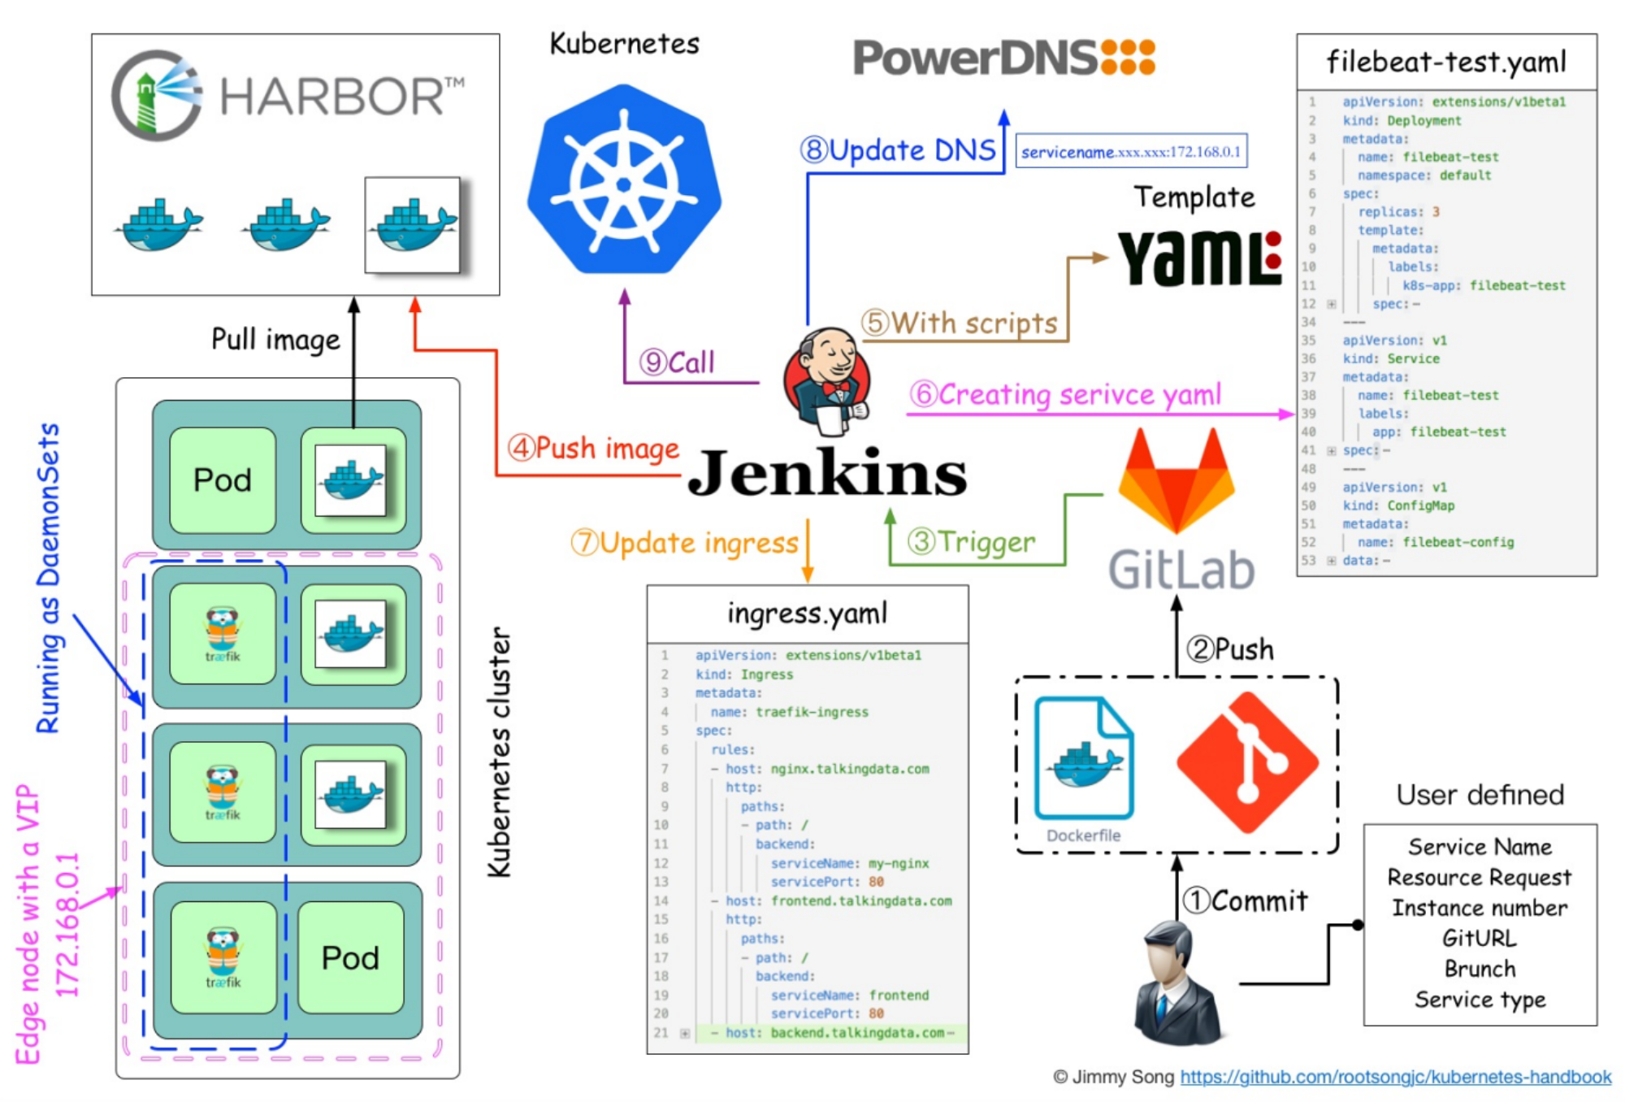

Slide 33
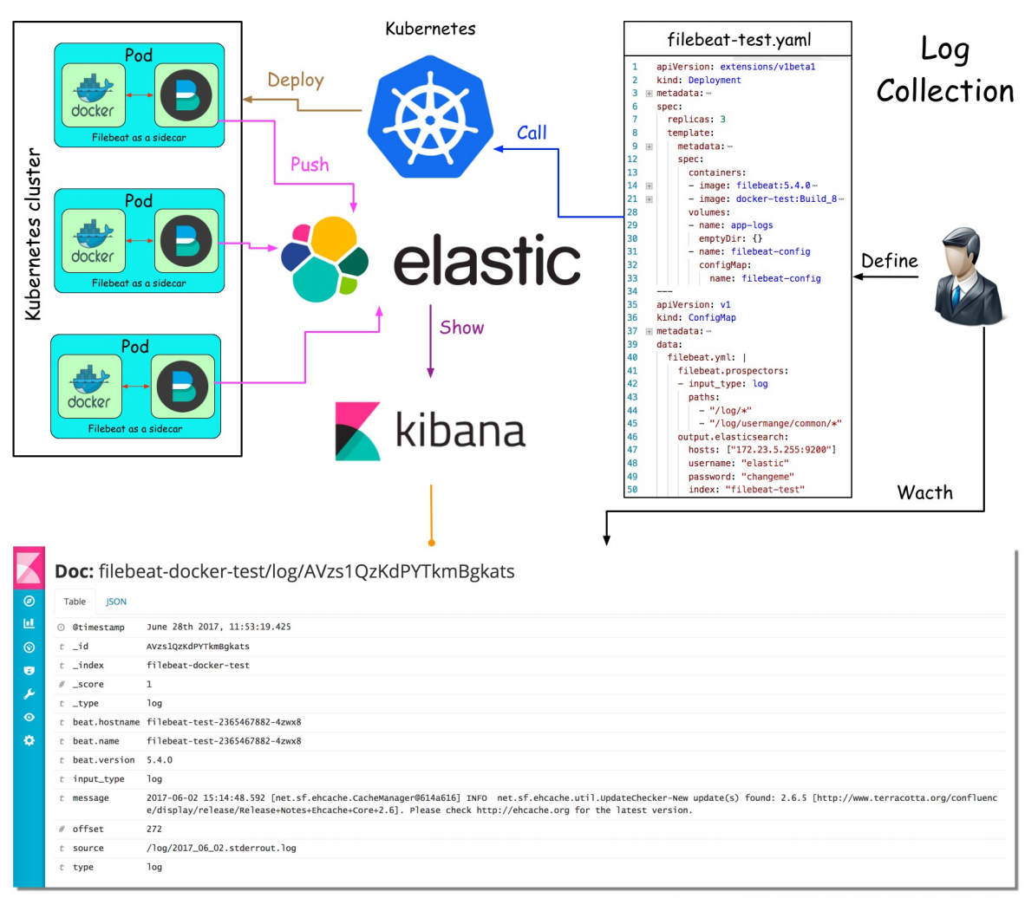

Slide 34
